Slide 1
Anatomy of an Application

Slide 2
A Component
const Banner = () => <h1>This is a banner</h1>;

Slide 3
Components are JavaScript functions that return jsx
JSX looks like HTML but it isn't
An alternative way to write JavaScript JSX: JavaScript eXtension
Translated to JavaScript by a tool Babel
Components
and JSX

Slide 4
JSX to Markup
<h1>
This is a banner
</h1>
React.createElement(
"h1", null, "This is a banner");
<h1>
This is a banner
</h1>
Babel
React DOM

Slide 5
Separation of Concerns
react
react-dom

Slide 6
Another Component
const Greeting = () => (
<div>
<Banner />
<h2 className="highlight">Greetings!</h2>
</div>
);

Slide 7
Correspond to DOM elements
Built-in Components
Different output targets use different built-in components
Are camelCased
Custom components are PascalCased

Slide 8
Class Components
class Greeting extends React.Component { render() {
return (
<div>
<Header/>
<h2 className="highlight">Hi there!</h2>
</div>
)
}
}

Slide 9
React team recommends functions
Component
Types
New future React features only available in functions
Functions are less verbose and easier to manage

Slide 10

Putting It All Together
const Banner = () => <h1>This is a banner</h1>;
<div>
<Banner />
<Chart />
</div>
React.createElement( ....
This is a banner

Slide 11


Slide 12
Composition 1
App
Header
HouseList

Slide 13
Composition 2
App
Header
House
Bids

Slide 14
Starting point
Transform JSX to JavaScript
Process JavaScript files Run a development server
Automatically update browser when source files change
Create a production build
Why Tooling is
Needed

Slide 15
Do It Yourself
Options for
Tooling
Use a ready-to-go development environment
Create React App (CRA)
Next.js

Slide 16
Development environment used in this course
Adds features
Next.js
Goal: pure React
Next.js has optional server-side features

Slide 17
React !== Next.js

Slide 18
Install Node.js
Download from nodejs.org

Slide 19
Modules

Slide 20
Modules
module.js
anotherModule.js
const doSomething = () => {
…
};
export { doSomething };
import { doSomething } from "./module";
doSomething();

Slide 21
Modules
module.js
anotherModule.js
const doSomething = () => {
…
};
export default doSomething;
Import do from "./module";
do();

Slide 22
React and Modules
banner.js
greeting.js
const Banner = () => (
<h1>
This is a banner
</h1>
);
export default Banner;
Import Banner from "./banner";
const Greeting = () => (
<Banner />
);

Slide 23
Code structure
Reusability
Encapsulation Needed for bundling
Reasons to Use
Modules

Slide 24
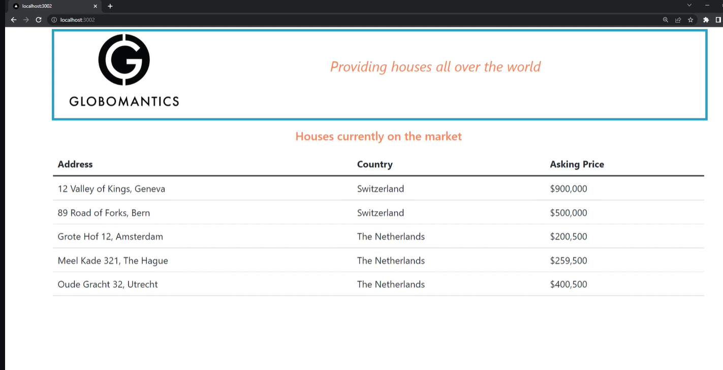

Slide 25
Detect problems
Code styling Commonly used
ESLint
Next.js: Built-in React ruleset

Slide 26
Every file in pages directory is a "page"
Just a component
Routing in
Next.js
Renders when filename matches with url
/contact => contact.js
index.js renders at the root url

Slide 27
Modify rules to your liking in the ESLint configuration file

